Slide 1
HOW TO PREPARE FOR GCSE SCIENCE
MR. M. BAKER
HEAD OF SCIENCE

Slide 2
IMPORTANT EXAM DATES May/June 2024
Duration of each of the 6 exam papers:
Combined Science - 1 hour 15 minutes
Triple - 1 hour 45 minutes
BIOLOGY PAPER 1 - 10TH MAY 1st
BIOLOGY PAPER 2 – 7TH JUNE 4th
CHEMISTRY PAPER 1 – 17TH MAY 2nd
CHEMISTRY PAPER 2 – 11TH JUNE 5th
PHYSICS PAPER 1 – 22nd MAY 3rd
PHYSICS PAPER 2 – 14TH JUNE 6th

Slide 3
REVISION RESOURCES – WE’VE GOT IT ALL! https://classroom.google.com/c/NjA4NzU3MDc0NDEy?cjc=5dz44fe
Approx. 40% of the exams are testing your knowledge and understanding.
Regularly go through the Required practicals – powerpoint with them all - in the Google classroom.
Revision guides – purchase on School gateway.
Blank Knowledge organisers are available in the Google classroom.
Tuesday Revision Sessions in S4 - 1.40 to 2.10 pm
Use free resources Cognito/Seneca/freesciencelessons.com/BBC Bitesize/Fuse videos/kerboodle.com

Slide 4
ASK YOURSELF THESE QUESTIONS?
Have I looked at the content for each of the Six papers, i.e. the modules are on kerboodle.com
What are the Required practicals examined in each paper?
How organised are you?
Do I know what the Command terms actually mean? e.g. Evaluate, Compare, etc….
Which Maths skills do I need to practise for the Science exams?
Which equations do I need to learn how to apply?
What are the ‘Working Scientifically’ skills examined in all six papers?

Slide 5
YEAR 11 2024 REVISION - GOOGLE CLASSROOM HOW DO I ACCESS THE ONLINE CLASSROOM?
5dz44fe
5dz44fe
Display
The all important code is: 5dz44fe
Login to Google
Click on the + sign
Enter the Code

Slide 6
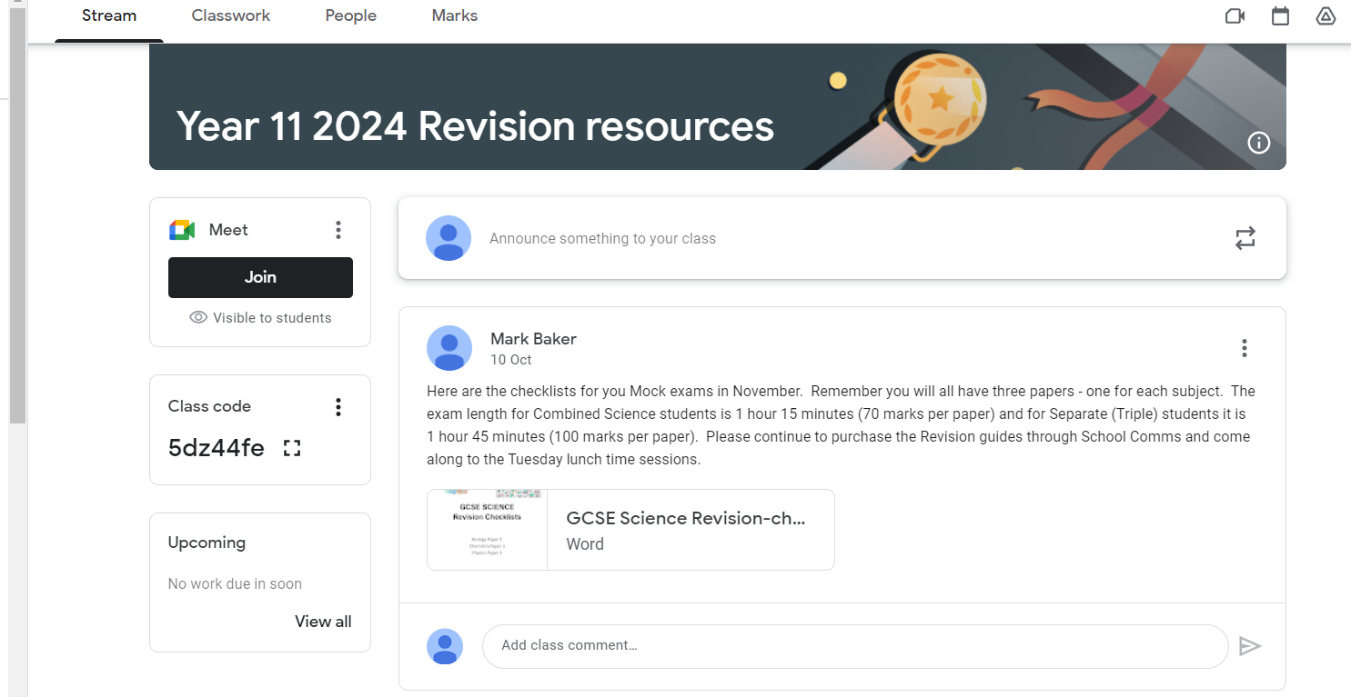

Slide 7
Type in the Class code here:
5dz44fe

Slide 8
FINAL WISE WORDS:
Access the Year 11 2024 Revision Google classroom and kerboodle.com
Download past papers - AQA exam board.
Need to ‘know what you know’ and what you don’t!
Organise your Revision notes for EACH paper – dividers/filing system.
Revise ACTIVELY! Don’t be passive – keep the phone ‘out of reach’ during the mock weeks!

